Slide 1
DIGITAL LOGIC DESIGN
Sequential Logic, RS Flip-Flop,
D Flip-Flop, JK Flip-Flop, T Flip-Flop

Slide 2
Introduction
A sequential circuit consists of a feedback path, and employs some memory elements.
Combinational outputs
Memory outputs
Combinational logic
Memory elements
External inputs
Sequential circuit = Combinational logic + Memory Elements
output= external input + present state of memory element

Slide 3
Introduction
There are two types of sequential circuits:
  synchronous: outputs change only at specific time (i.e. with clock input)
  asynchronous: outputs change at any time (i.e. without clock input)
Multivibrator: a class of sequential circuits. They can be:
  bistable (2 stable states)
  monostable or one-shot (1 stable state)
  astable (no stable state)
Bistable logic devices: flip-flops.
Flip-flops differ in the method used for changing their state.

Slide 4
Memory Elements
Memory element: a device which can remember value indefinitely, or change value on command from its inputs.
Memory element
Q
command
stored value
Q(t): current state
Q(t+1) or Q⁺: next state

Slide 5
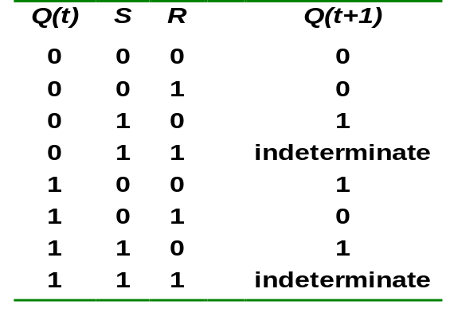
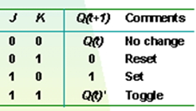
Types of tables in sequential circuit
Characteristic table
Truth/Criteria Table

Slide 6
SR Latch Using NAND Gate

Slide 7
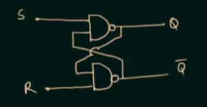
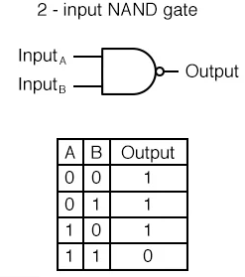
We will need the knowledge of this truth table later

Slide 8
Case 1:
S=0, R=1, Q=1, Q’=0 [Calculation of Q done first]
S=1, R=1, Q=1, Q’=0
Case 2:
S=1, R=0, Q=0, Q’=1 [Calculation of Q’ done first]
S=1, R=1, Q=0, Q’=1
Case 3:
S=0, R=0, Q=1, Q’=1 (Impossible)
Truth Table for SR Latch (NAND Gate)
S | R | Q | Q’
0 | 0 | Not Used
0 | 1 | 1 | 0
1 | 0 | 0 | 1
1 | 1 | Memory/ No change

Slide 9
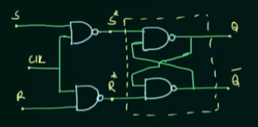
S-R Flip-Flop
Now we will use the knowledge of SR latch to build the truth table for SR FF. But before that, we need to do some calculation.

Slide 10
S-R Flip-Flop (Truth Table)
S* = (S.CLK)’=S’+CLK’
R* = (R.CLK)’=R’+CLK’
Now, for a FF to work, CLK must be 1.
If CLK=1, then,
S*= S’+0 = S’
R*=R’+0=R’
If,
S=0, R=0, then S*=1, R*=1
S=0, R=1, then S*=1, R*=0
S=1, R=0, then S*=0, R*=1
S=1, R=1, then S*=0, R*=0
Let’s build the truth table now [this table also includes latch inputs which are S* and R*. In the final truth table, you can ignore these two columns as shown in the right side.
S | R | S* | R* | Q | Q’
0 | 0 | 1 | 1 | Memory/ No change
0 | 1 | 1 | 0 | 0 | 1
1 | 0 | 0 | 1 | 1 | 0
1 | 1 | 0 | 0 | Not Used
S | R | Q | Q’
0 | 0 | Memory/ No change
0 | 1 | 0 | 1
1 | 0 | 1 | 0
1 | 1 | Not Used

Slide 11
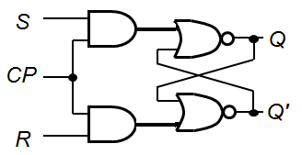
Clocked S-R FF Diagram
S-R FF + Clock Pulse (CP) and 2 NAND gates → Clocked S-R FF.
S
CP
R
Q
Q'
Can also be drawn like this
Block Diagram

Slide 12
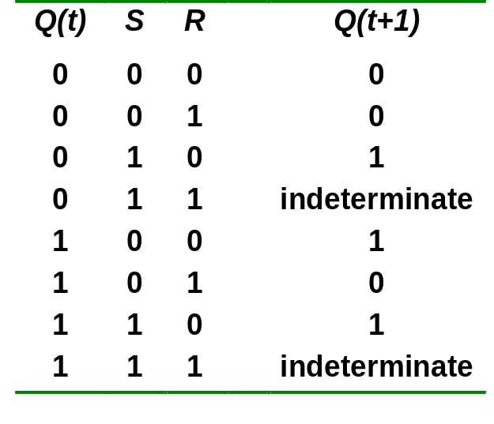
S-R Flip-Flop Truth + Characteristics Table
S | R | Q | Q’
0 | 0 | Memory/ No change
0 | 1 | 0 | 1
1 | 0 | 1 | 0
1 | 1 | Not Used
While building the Characteristics table, always consider Q from the truth table as Q’ is just the compliment of Q.
Characteristics Table
You always need to remember the truth table to build the characteristics table. Meaning, truth table comes first, characteristics table comes second. You can’t build characteristics table before truth table

Slide 13
Clocked D Flip-Flop
Make R input equal to S' → D FF.
D FF eliminates the undesirable condition of invalid state in the S-R FF.
D
D
CLK
Q
Q
Q'
CLK
Q'

Slide 14
D Flip-flop Truth table
D | Q | Q’
0 | 0 | 1
1 | 1 | 0

Slide 15
D Flip-flop Characteristic table
Q(t) | D | Q(t+1)
0 | 0 | 0
0 | 1 | 1
1 | 0 | 0
1 | 1 | 1

Slide 16
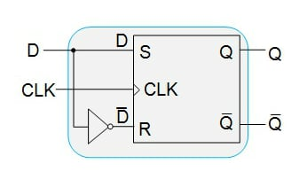
Try it yourself (Don’t Ignore)
Design a D FF using RS FF (Learn it yourself) (Draw both circuit and block diagram)
D
Q
CLK
Q'

Slide 17
J-K Flip-flop
J-K flip-flop: Q and Q' are fed back to the NAND gates.
No invalid state.
Include a toggle state.
  J=HIGH (and K=LOW)  SET state
  K=HIGH (and J=LOW)  RESET state
  both inputs LOW  no change
  both inputs HIGH  toggle

Slide 18
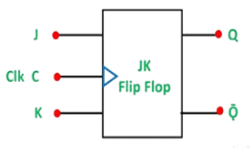
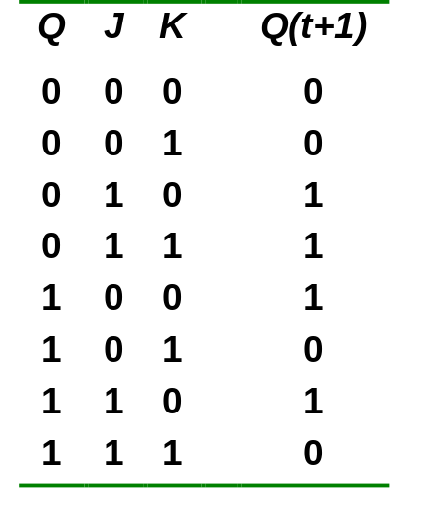
J-K Flip-flop
J-K flip-flop.
Characteristic table.
J
Q
Pulse transition detector
CLK
Q'
Truth Table
K
J | K | Q | Q’
0 | 0 | Memory/ No change
0 | 1 | 0 | 1
1 | 0 | 1 | 0
1 | 1 | Toggle
This truth table is same as SR except the last row
This is because, J-K FF solves only that “Not Used” problem of SR FF and keeps everything else same as before

Slide 19
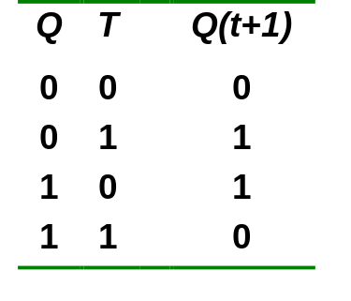
T Flip-flop
T flip-flop: single-input version of the J-K flip flop, formed by tying both inputs together.
T
T
J
C
K
Q
Q
Q'
Pulse transition detector
CLK
CLK
Q'
Truth Table
Characteristics Table
T | Q | Q’
0 | No Change
1 | Toggle

Slide 20
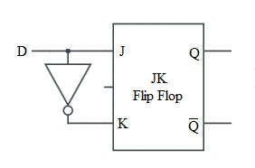
Try it yourself (Don’t Ignore)
Design a T FF using JK FF
Design a D FF using JK FF
(Draw block diagram) (Learn it yourself)
(Try the circuit diagram yourself)
T
J
C
K
Q
Q'
CLK

Slide 21
